Slide 1
Introduction to Silverlight 2
Daniel Moth
Microsoft
daniel.moth@microsoft.com
http://www.danielmoth.com/Blog

Slide 2






Web vs. Client
search
HTML
script
AJAX
Silverlight 1.0

Slide 3

.NET Everywhere !
search

Slide 4




Supported Platforms

Slide 5
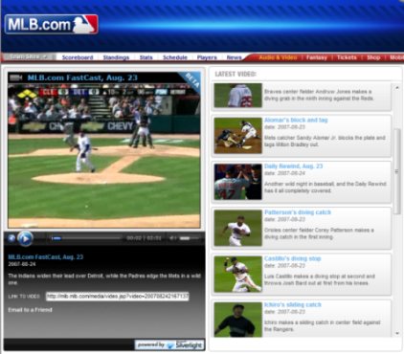
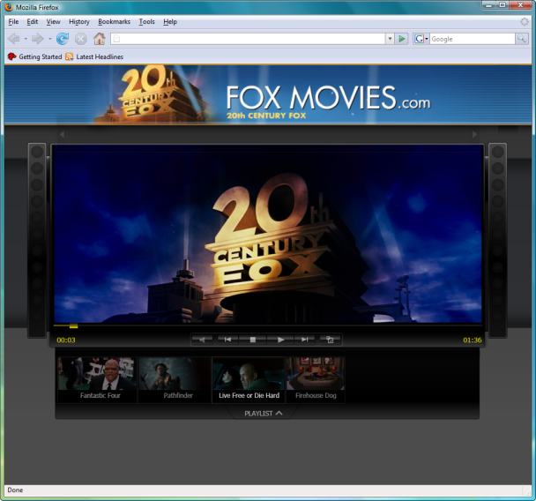
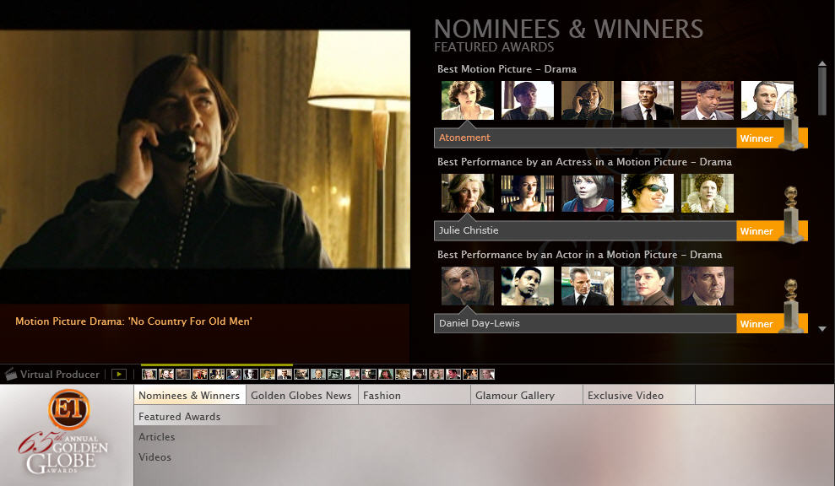
Rich Internet Applications
http://www.danielmoth.com/Blog/2008/05/silverlight-example-apps.html
demo

Slide 6



What You Need To Install
2 Beta 1 Tools for Visual Studio
Expression Blend 2.5 CTP

Slide 7
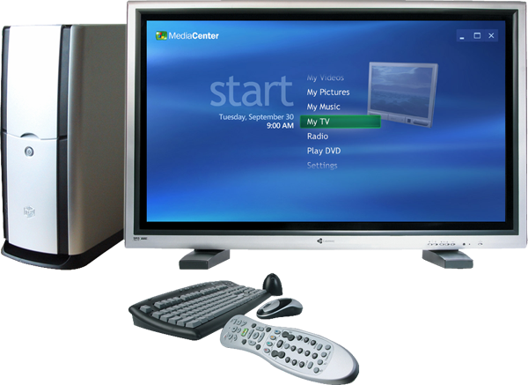
AGENDA
Hello World?
search
HTML
(script)

Slide 8
AGENDA
0. Set the scene
1. Hello World
2. XAML-based GUI
3. Browser Integration
4. Networking
5. Access File System
Hello World?
search
HTML
(script)

Slide 9
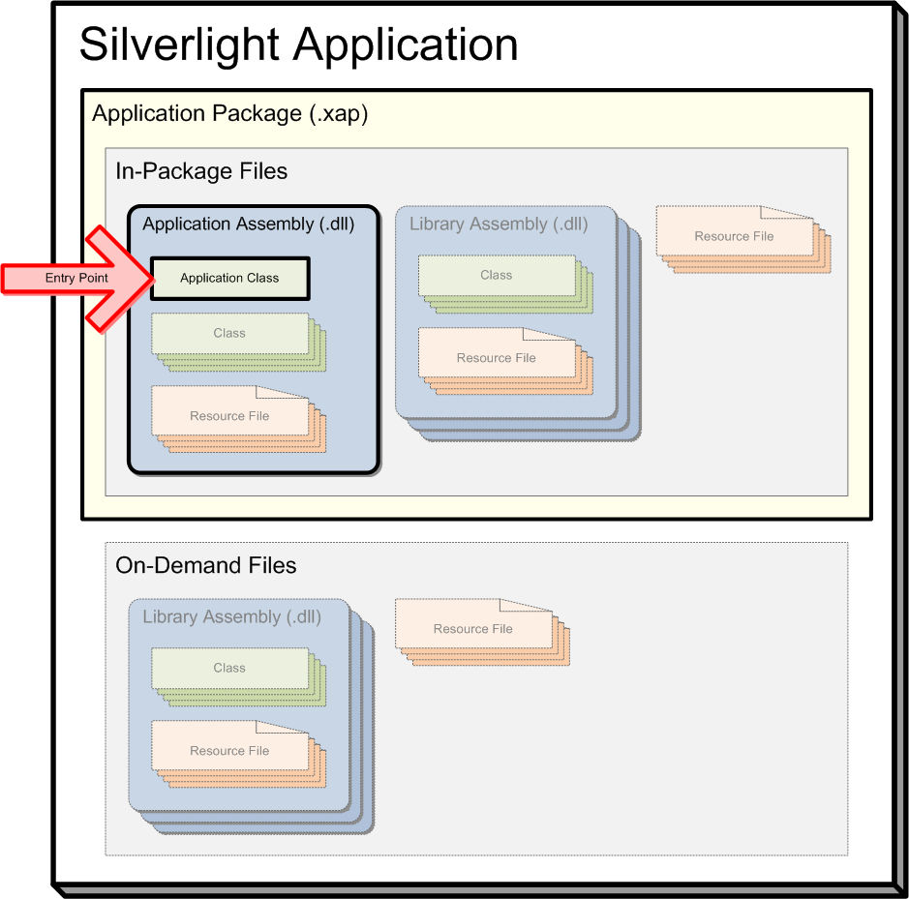
Application Model

Slide 10
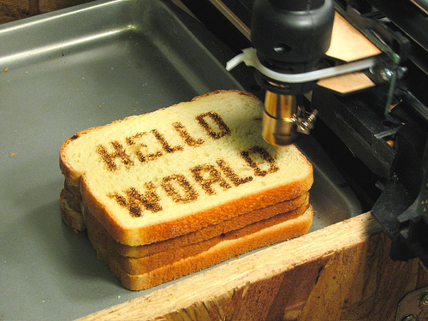
Getting Started
http://www.danielmoth.com/Blog/2008/04/silverlight-2-essential-getting-started.html
demo

Slide 11
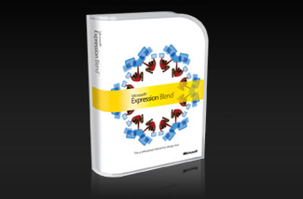
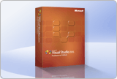
Rich User Interface
Expression Blend
Visual Studio 2008
Visual Studio Project Files
eXtensible Application Markup Language

Slide 12

XAML-based UI
http://www.danielmoth.com/Blog/2008/05/xaml-level-100.html
demo

Slide 13
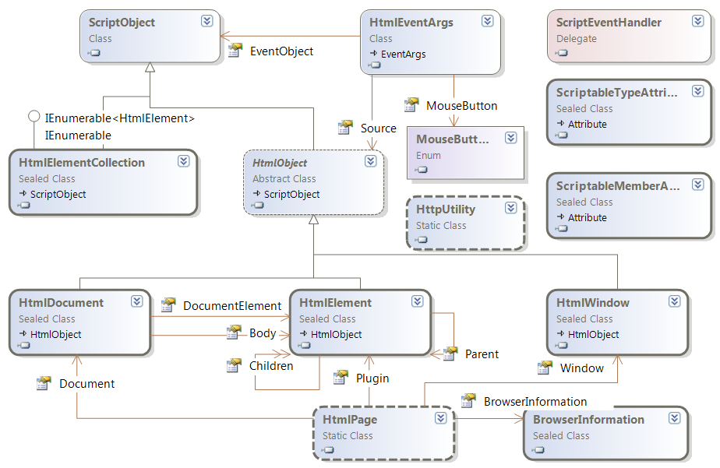
Browser Integration

Slide 14

HTML Bridge
http://www.danielmoth.com/Blog/2008/03/silverlight-browser-integration-aka.html
demo

Slide 15






Many Types of Outside Data
Images
Sounds
Videos
RSS/Atom
Feeds
New services
you build
In-Browser Application
Existing
Intranet
services
Public
Internet
mashup APIs

Slide 16











Networking
http://www.danielmoth.com/Blog/2008/04/networking-in-silverlight-2-beta-1.html
demo

Slide 17
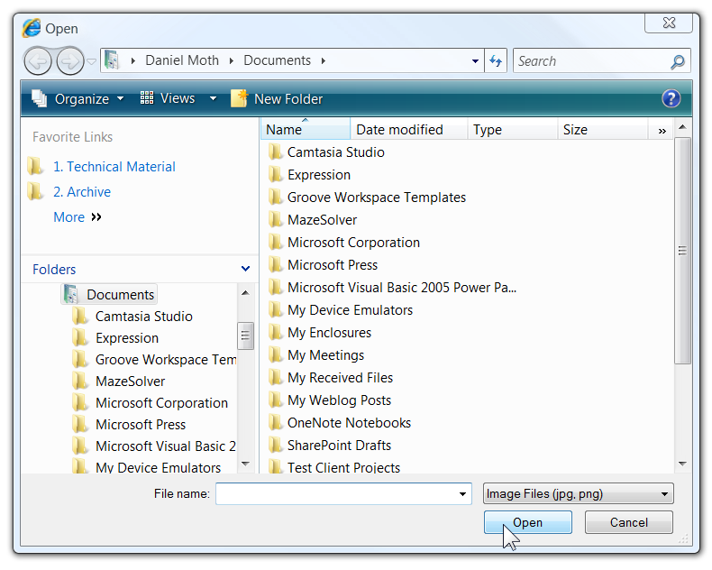


Access File System

Slide 18
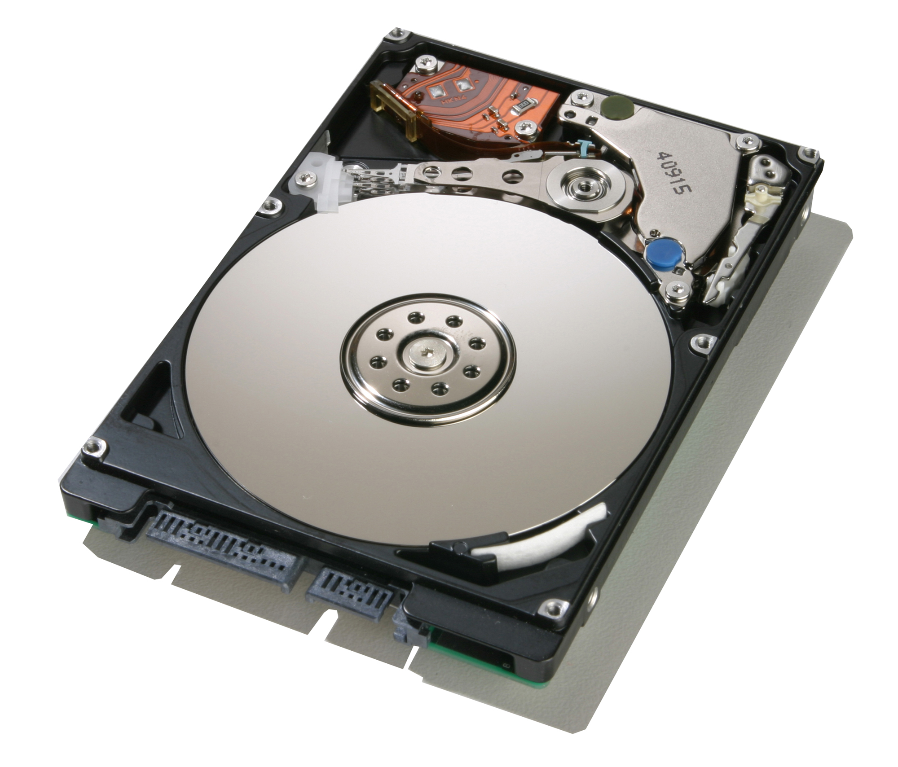
IsolatedStorage, OpenFileDialog
http://www.danielmoth.com/Blog/2008/04/isolatedstorage-in-siverlight-2-beta-1.html
http://www.danielmoth.com/Blog/2008/04/openfiledialog-and-filedialogfileinfo.html
demo

Slide 19

Summary
Cross-browser, cross-platform
.NET Everywhere
  Relevant subset of the full .NET Framework
Rich User Experience
  XAML-based UI
  WPF subset
Get started now with Beta 1
www.silverlight.net

Slide 20

© 2007 Microsoft Corporation. All rights reserved. Microsoft, Windows, Windows Vista and other product names are or may be registered trademarks and/or trademarks in the U.S. and/or other countries.
The information herein is for informational purposes only and represents the current view of Microsoft Corporation as of the date of this presentation. Because Microsoft must respond to changing market conditions, it should not be interpreted to be a commitment on the part of Microsoft, and Microsoft cannot guarantee the accuracy of any information provided after the date of this presentation.
MICROSOFT MAKES NO WARRANTIES, EXPRESS, IMPLIED OR STATUTORY, AS TO THE INFORMATION IN THIS PRESENTATION.

