Slide 1
Parallel Extensions to the .NET Framework
Daniel Moth
Microsoft
http://www.danielmoth.com/Blog

Slide 2
Threading 101
On Single Core Machine
Don’t block the UI
Thread Affinity
Async Operations
Synchronization Issues
On Multi-core Machine
As above...
... plus Improve Actual Performance

Slide 3
The Manycore Shift
“[A]fter decades of single core processors, the high volume processor industry has gone from single to dual to quad-core in just the last two years. Moore’s Law scaling should easily let us hit the 80-core mark in mainstream processors within the next ten years and quite possibly even less.” -- Justin Ratner, Chief Technology Officer, Intel
“If you haven’t done so already, now is the time to take a hard look at the design of your application, determine what operations are CPU-sensitive now or are likely to become so soon, and identify how those places could benefit from concurrency.” -- Herb Sutter, C++ Architect at Microsoft
"[T]he world is going to move more and more away from one CPU that is multiplexed to do everything to many CPUs... [C]oncurrency is a real challenge, because the way the industry has grown up writing software - the languages that we chose, the model of synchronization and orchestration - are actually not things that lend themselves toward either exposing parallelism or allowing large-scale composition of big systems“ -- Craig Mundie, Chief Research and Strategy Officer, Microsoft

Slide 4
Example Code to Parallelize Matrix multiplication (sequential)
void MultiplyMatrices(int size, double[,] m1, double[,] m2, double[,] result)
{
for (int i = 0; i < size; i++) {
for (int j = 0; j < size; j++) {
result[i, j] = 0;
for (int k = 0; k < size; k++) {
result[i, j] += m1[i, k] * m2[k, j];
}
}
}
}

Slide 5
Static Work Distribution
int N = size;
int P = 2 * Environment.ProcessorCount;
int Chunk = N / P; // size of a work chunk
ManualResetEvent signal = new ManualResetEvent(false);
int counter = P; // use a counter to reduce kernel transitions
for (int c = 0; c < P; c++) { // for each chunk
ThreadPool.QueueUserWorkItem(o => {
int lc = (int)o;
for (int i = lc * Chunk; // process one chunk
i < (lc + 1 == P ? N : (lc + 1) * Chunk); // respect upper bound
i++) {
// original loop body
for (int j = 0; j < size; j++) {
result[i, j] = 0;
for (int k = 0; k < size; k++) {
result[i, j] += m1[i, k] * m2[k, j];
}
}
}
if (Interlocked.Decrement(ref counter) == 0) { // efficient interlocked ops
signal.Set(); // and kernel transition only when done
}
}, c);
}
signal.WaitOne();
Knowledge of Synchronization Primitives
High Overhead
Error Prone
Tricks
Lack of Thread Reuse
Heavy Synchronization

Slide 6
Parallel Extensions to the .NET Framework
.NET library
Supports parallelism in any .NET language, without changes to compilers or the CLR
Begins to move concurrency from experts to mainstream .NET developers

Slide 7
Matrix multiplication (Seq)
void MultiplyMatrices(int size, double[,] m1, double[,] m2, double[,] result)
{
for (int i = 0; i < size; i++) {
for (int j = 0; j < size; j++) {
result[i, j] = 0;
for (int k = 0; k < size; k++) {
result[i, j] += m1[i, k] * m2[k, j];
}
}
}
}

Slide 8
Matrix multiplication (Par)
void MultiplyMatrices(int size, double[,] m1, double[,] m2, double[,] result)
{
Parallel.For(0, size, i => {
for (int j = 0; j < size; j++) {
result[i, j] = 0;
for (int k = 0; k < size; k++) {
result[i, j] += m1[i, k] * m2[k, j];
}
}
});
}

Slide 9
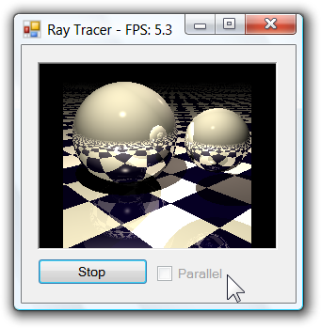
Sample: Raytracer
demo

Slide 10
AGENDA for Remainder Session
Task and friends
Imperative Task parallelism
Parallel class
Parallel LINQ (PLINQ)
Declarative Data parallelism
Imperative Data parallelism

Slide 11
Task class
The lightweight unit of work
May run concurrently if it’s “worth it”
Supports
parent/child relations
explicit grouping
cancelation
waiting

Slide 12
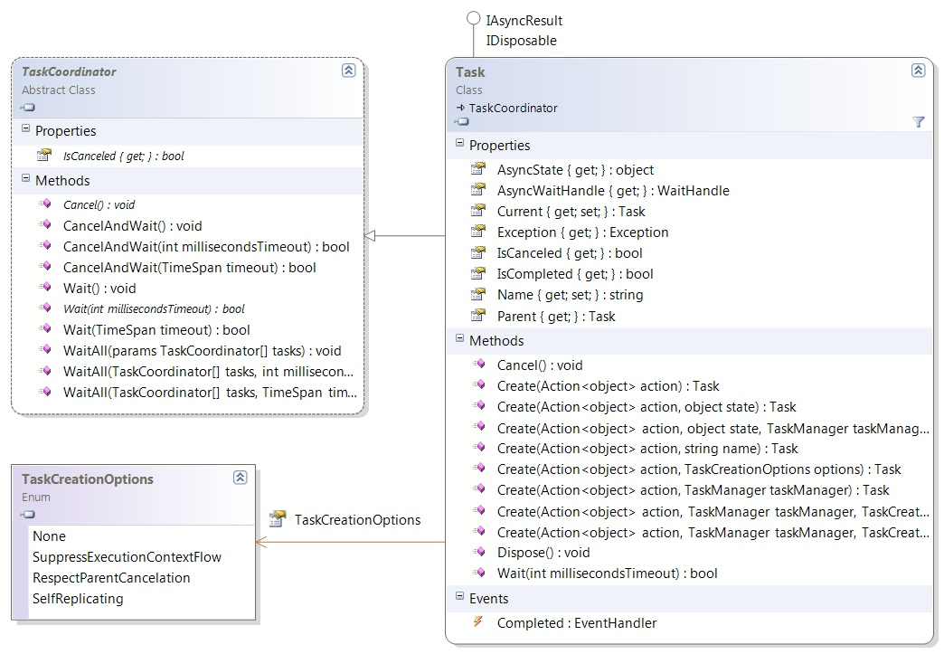
From Threads to Tasks
demo

Slide 13
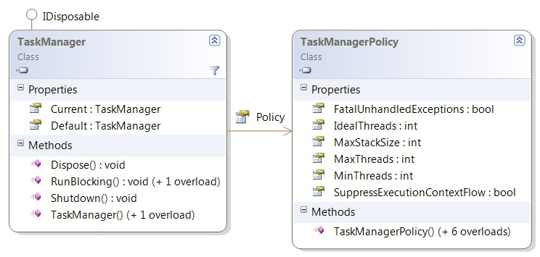
TaskManager class
Represents a scheduler group
think of it as a fancy thread-pool
one implicit to each AppDomain
can create explicitly for isolation
configurable

Slide 14
“Work Stealing” in Action
…
Worker Thread 1
Worker Thread p
…
Program Thread
Task 3
Task 1
Task 4
Task 5
Task 2

Slide 15
Imperative Data Parallelism
Parallel class
static (overloaded) methods
helper methods to create/work with Tasks
encapsulates common patterns

Slide 16
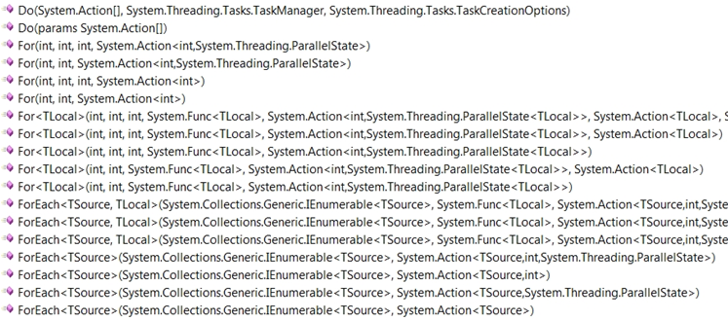
Parallel.For
demo

Slide 17
Parallel Statements
Program statements…
…when independent, can be parallelized
Synchronous (same as loops)
StatementA();
StatementB();
StatementC();
Parallel.Do(
() => StatementA(),
() => StatementB(),
() => StatementC() );

Slide 18
Declarative Data Parallelism
Parallel LINQ-to-Objects
Enables LINQ devs to leverage manycore
Fully supports all .NET standard query operators
Minimal impact to existing LINQ model
var q = from p in people
where p.Name == queryInfo.Name &&
p.State == queryInfo.State &&
p.Year >= yearStart &&
p.Year <= yearEnd
orderby p.Year ascending
select p;
.AsParallel()

Slide 19
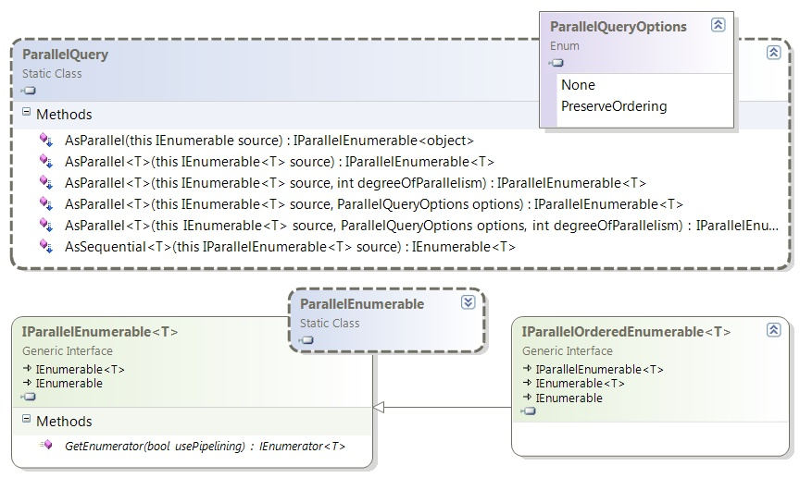
Parallel LINQ (PLINQ)
demo

Slide 20
PLINQ – Modes of Consumption
Pipelined: separate consumer thread
Default for GetEnumerator()
And hence foreach loops
More synchronization overhead
Stop-and-go: consumer helps
Sorts, ToArray, ToList, GetEnumerator(false), etc.
Minimizes context switches
But higher latency and more memory
Inverted: no merging needed
ForAll extension method
Most efficient by far
But more difficult (side-effects)
Thread 2
Thread 1
Thread 3
Thread 1
Thread 4
Thread 1
Thread 1
Thread 2
Thread 1
Thread 3
Thread 1
Thread 1
Thread 2
Thread 1
Thread 3

Slide 21
Summary – Parallel Extensions
Task Parallel Library (TPL)
Imperative Task Parallelism – TaskManager etc
Imperative Data Parallelism – Parallel
Parallel LINQ (PLINQ)
Declarative Data Parallelism – AsParallel
Coordination Data Structures (CDS)
Thread-safe collections, Work exchange constructs, Phased operation primitives, Locks, Initialization support

Slide 22
Resources
Binaries, Code, Forums, blogs, videos, screencasts, podcasts, articles, samples
My blog for resources to this session
http://msdn.microsoft.com/concurrency
http://www.danielmoth.com/Blog

Slide 23
© 2008 Microsoft Corporation. All rights reserved. Microsoft, Windows, Windows Vista and other product names are or may be registered trademarks and/or trademarks in the U.S. and/or other countries.
The information herein is for informational purposes only and represents the current view of Microsoft Corporation as of the date of this presentation. Because Microsoft must respond to changing market conditions, it should not be interpreted to be a commitment on the part of Microsoft, and Microsoft cannot guarantee the accuracy of any information provided after the date of this presentation. MICROSOFT MAKES NO WARRANTIES, EXPRESS, IMPLIED OR STATUTORY, AS TO THE INFORMATION IN THIS PRESENTATION.

