Slide 1
Harnessing GPU compute with C++ Accelerated Massive Parallelism
Daniel Moth
Principal Program Manager
Developer Division
Microsoft Corporation

Slide 2
Changes in the C++ AMP Beta
restrict(direct3d) is renamed to restrict(amp). We shared that here.
Replaced grid, tiled_grid with extent and tiled_extent instead. We shared that here.
Added amp_graphics.h with concurrency:graphics namespace with Short Vector Types and Textures. We shared that here.
Changed default queuing _mode not to be immediate, and changed enum names slightly. We shared that here.
Added .wait(…) overloads to tile_barrier for finer grained control. We shared that here.
Replaced <writeonly<…> as option for array_view with .discard_data(). We shared that here.
Moved math functions to amp_math.h in fast_math and precise_math namespaces. We shared that here.
Replaced accelerator_restriction with .supports_double_precision + another property. We shared that here.
Removed all overloads that accepted accelerator instead use .default_view. We shared that here.
Added .set_default() to accelerator and changed how we pick the default. We shared that here.
Replaced global get_all_accelerators function with accelerator::get_all(). We shared that here.
Removed .z, .y, .x and instead use the subscript operator [0], [1], [2]. We shared that here .
Added .pad(), .truncate() to tiled_extent. We shared that here .
Added accelerator_view_removed exception to help with TDR case. We shared that here .
Added .synchronize_async() to array_view, and made the other _async() methods work. We shared that here.
Added create_marker() to accelerator_view. We shared that here .
Removed .project() on array_view and instead you can still use subscript operator. We shared that here.
Changed the signature for a couple of the atomic operations. We shared that here.
Changed the type of D3D buffer underling C++ AMP arrays (minor impact to interop). We shared that here.
Made triple-digit number of bug fixes including perf improvements.

Slide 3
Agenda
Context
Code
IDE
Summary

Slide 4
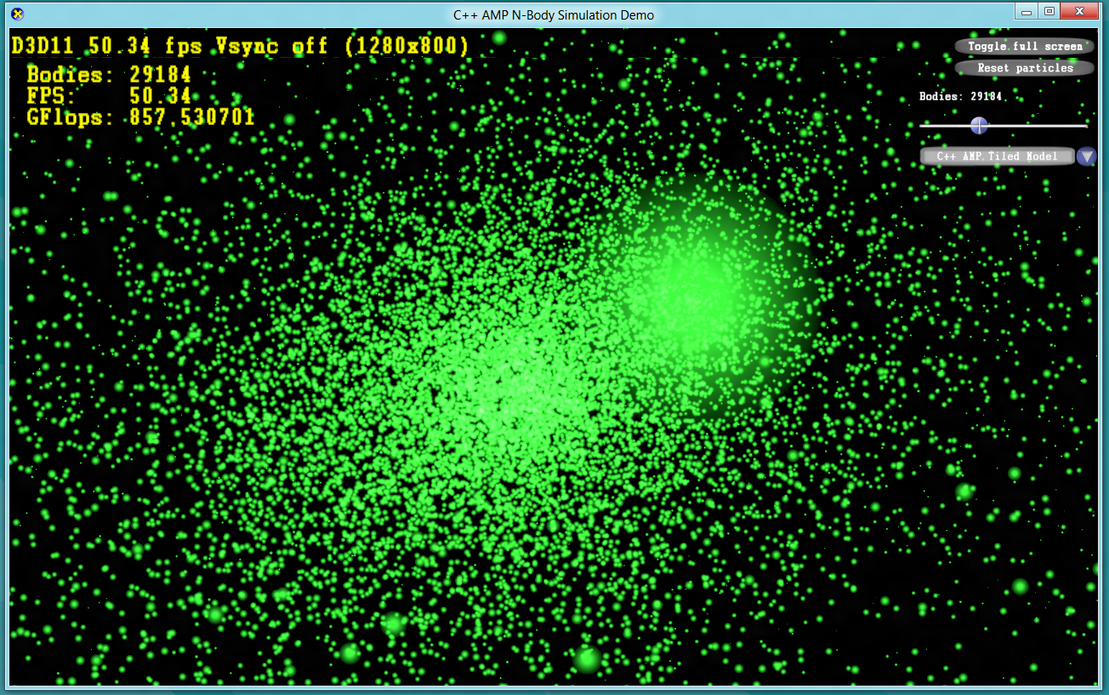
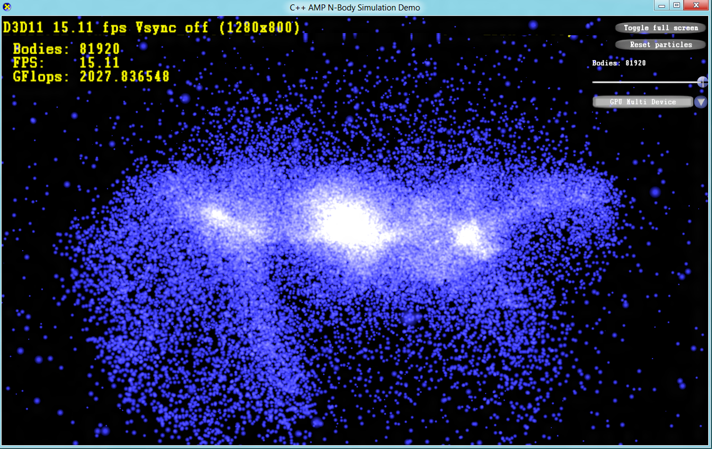
N-Body
http://blogs.msdn.com/b/nativeconcurrency/archive/2011/09/20/c-amp-n-body-simulation-sample.aspx

Slide 5
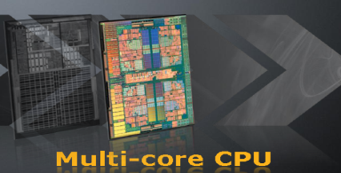
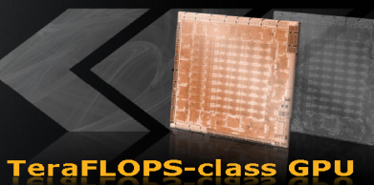
CPUs vs GPUs today
CPU
GPU
Low memory bandwidth
Higher power consumption
Medium level of parallelism
Deep execution pipelines
Random accesses
Supports general code
Mainstream programming
High memory bandwidth
Lower power consumption
High level of parallelism
Shallow execution pipelines
Sequential accesses
Supports data-parallel code
Niche programming
images source: AMD

Slide 6
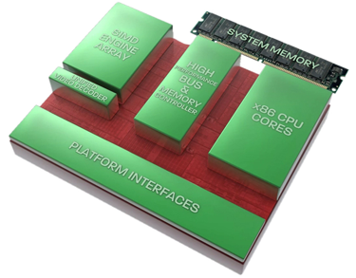
Tomorrow…
CPUs and GPUs coming closer together…
…nothing settled in this space, things still in motion…
C++ AMP is designed as a mainstream solution not only for today, but also for tomorrow
image source: AMD

Slide 7
C++ AMP
Part of Visual C++
Visual Studio integration
STL-like library for multidimensional data
Builds on Direct3D
An open specification
performance
productivity
portability
http://www.danielmoth.com/Blog/C-Accelerated-Massive-Parallelism.aspx

Slide 8
Agenda checkpoint
Context
Code
Simple Model
Tiled Model
(optional) More
IDE
Summary

Slide 9
Hello World: Array Addition
void AddArrays(int n, int * pA, int * pB, int * pSum)
{
for (int i=0; i<n; i++)
{
pSum[i] = pA[i] + pB[i];
}
}
How do we take the serial code on the left that runs on the CPU and convert it to run on an accelerator like the GPU?

Slide 10
Hello World: Array Addition
void AddArrays(int n, int * pA, int * pB, int * pSum)
{
for (int i=0; i<n; i++)
{
pSum[i] = pA[i] + pB[i];
}
}
void AddArrays(int n, int * pA, int * pB, int * pSum)
{
for (int i=0; i<n; i++)
{
pSum[i] = pA[i] + pB[i];
}
}
#include <amp.h>
using namespace concurrency;
void AddArrays(int n, int * pA, int * pB, int * pSum)
{
array_view<int,1> a(n, pA);
array_view<int,1> b(n, pB);
array_view<int,1> sum(n, pSum);
parallel_for_each(
sum.extent,
[=](index<1> i) restrict(amp)
{
sum[i] = a[i] + b[i];
}
);
}

Slide 11
Basic Elements of C++ AMP coding
void AddArrays(int n, int * pA, int * pB, int * pSum)
{
array_view<int,1> a(n, pA);
array_view<int,1> b(n, pB);
array_view<int,1> sum(n, pSum);
parallel_for_each(
sum.extent,
[=](index<1> i) restrict(amp)
{
sum[i] = a[i] + b[i];
}
);
}
parallel_for_each: execute the lambda on the accelerator once per thread
restrict(amp): tells the compiler to check that this code conforms to C++ AMP language restrictions
array_view: wraps the data to operate on the accelerator
extent: the number and shape of threads to execute the lambda
array_view variables captured and associated data copied to accelerator (on demand)
index: the thread ID that is running the lambda, used to index into data

Slide 12
extent<N> and index<N>
index<N> - an N-dimensional point
extent<N> - # of units in each dimension of an N-dim space
rank N can be any number <=128
index<1> i(2);
index<2> i(0,2);
index<3> i(2,0,1);
extent<1> e(6);
extent<2> e(3,4);
extent<3> e(3,2,2);
http://www.danielmoth.com/Blog/concurrencyindex-From-Amph.aspx
http://www.danielmoth.com/Blog/concurrencyextent-From-Amph.aspx

Slide 13
array_view<T,N>
View on existing data on the CPU or GPU
Dense in least significant dimension
Of element T and rank N
Requires extent
Rectangular
Access anywhere (implicit sync)
vector<int> v(10);
extent<2> e(2,5);
array_view<int,2> a(e, v);
index<2> i(1,3);
int o = a[i]; // or a[i] = 16;
//or int o = a(1, 3);
//above two lines can also be written
//array_view<int,2> a(2,5,v);
http://www.danielmoth.com/Blog/array-And-Arrayview-From-Amph.aspx

Slide 14
parallel_for_each
Executes the kernel for each point in the extent
As-if synchronous in terms of visible side-effects
parallel_for_each(
e, //e is of type extent<N>
[ ](index<N> idx) restrict(amp)
{
// kernel code
}
);
http://www.danielmoth.com/Blog/parallelforeach-From-Amph-Part-1.aspx

Slide 15
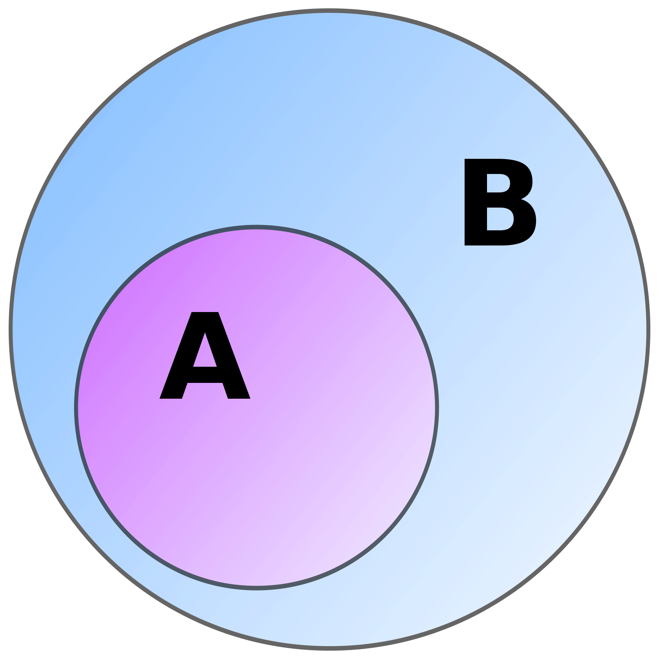
restrict( . . . )
Applies to functions (including lambdas)
restrict(…) informs the compiler to enforce language restrictions
e.g., target-specific restrictions, optimizations, special code-gen
In 1st release we are only implementing two options
cpu – the implicit default
amp – checks that the function conforms to C++ AMP restrictions
http://blogs.msdn.com/b/nativeconcurrency/archive/2011/09/05/restrict-a-key-new-language-feature-introduced-with-c-amp.aspx

Slide 16
restrict(amp) restrictions
Can only call other restrict(amp) functions
All functions must be inlinable
Only amp-supported types
int, unsigned int, float, double, bool¹
structs & arrays of these types
Pointers and References
Lambdas cannot capture by reference¹, nor capture pointers
References and single-indirection pointers supported only as local variables and function arguments

Slide 17
restrict(amp) restrictions
No
recursion
'volatile'
virtual functions
pointers to functions
pointers to member functions
pointers in structs
pointers to pointers
bitfields
No
goto or labeled statements
throw, try, catch
globals or statics
dynamic_cast or typeid
asm declarations
varargs
unsupported types
e.g. char, short, long double
http://blogs.msdn.com/b/nativeconcurrency/archive/2011/12/19/restrict-amp-restrictions-part-0-of-n-introduction.aspx

Slide 18
Example: restrict overloading
double cos( double d ); // 1a: cpu code
double cos( double d ) restrict(amp); // 1b: amp code
double bar( double d ) restrict(cpu,amp); // 2 : common subset of both
void some_method(array_view<double,2>& c) {
parallel_for_each( c.extent, [=](index<2> idx) restrict(amp)
{
//…
double d0 = c[idx];
double d1 = bar(d0); // ok, bar restrictions include amp
double d2 = cos(d0); // ok, chooses amp overload
//…
});
}

Slide 19
Example: Matrix Multiplication
void MatrixMultiplySerial( vector<float>& vC,
const vector<float>& vA,
const vector<float>& vB, int M, int N, int W )
{
for (int row = 0; row < M; row++) {
for (int col = 0; col < N; col++){
float sum = 0.0f;
for(int i = 0; i < W; i++)
sum += vA[row * W + i] * vB[i * N + col];
vC[row * N + col] = sum;
}
}
}
void MatrixMultiplyAMP( vector<float>& vC,
const vector<float>& vA,
const vector<float>& vB, int M, int N, int W )
{
array_view<const float,2> a(M,W,vA),b(W,N,vB);
array_view<float,2> c(M,N,vC);
c.discard_data();
parallel_for_each(c.extent,
[=](index<2> idx) restrict(amp) {
int row = idx[0]; int col = idx[1];
float sum = 0.0f;
for(int i = 0; i < W; i++)
sum += a(row, i) * b(i, col);
c[idx] = sum;
}
);
}

Slide 20
accelerator, accelerator_view
Host
Accelerator (e.g. discrete GPU)
accelerator
e.g. DX11 GPU
e.g. WARP, REF
e.g. CPU
accelerator_view
a context for scheduling and memory management
CPUs
PCIe
GPU
GPU
System memory
GPU
GPU
http://www.danielmoth.com/Blog/concurrencyaccelerator.aspx http://www.danielmoth.com/Blog/concurrencyacceleratorview.aspx

Slide 21
Example: accelerator
// enumerate all accelerators
vector<accelerator> accs = accelerator::get_all();
// choose one based on your criteria
accelerator acc = accs[0];
// launch a kernel on it
parallel_for_each(acc.default_view, my_extent, [=]…);

Slide 22
array<T,N>
Multi-dimensional array of rank N with element T
Container whose storage lives on a specific accelerator
Capture by reference [&] in the lambda
Explicit copy
Nearly identical interface to array_view<T,N>
vector<int> v(8 * 12);
extent<2> e(8,12);
accelerator acc = …
array<int,2> a(e, acc.default_view);
copy_async(v.begin(), v.end(), a);
parallel_for_each(e, [&](index<2> idx) restrict(amp)
{
a[idx] += 1;
});
copy(a, v.begin());
http://www.danielmoth.com/Blog/array-And-Arrayview-From-Amph.aspx

Slide 23
C++ AMP at a Glance (so far)
restrict(amp, cpu)
parallel_for_each
class accelerator_view
class accelerator
class extent<N>
class index<N>
class array_view<T,N>
class array<T,N>
Notes:
Simple model done, now moving to tiled model

Slide 24
Hardware from a Developer Perspective
…
…
thread
…
…
…
…
…
…
Per Thread Registers
Global Memory
Not showing:
Constant memory
Memory controllers
Schedulers
Other caches
Multi-GPU case

Slide 25
Hardware from a Developer Perspective
…
…
tile of threads
…
…
…
…
…
…
Per Thread Registers
Per Thread Registers
Global Memory
Not showing:
Constant memory
Memory controllers
Schedulers
Other caches
Multi-GPU case

Slide 26
Hardware from a Developer Perspective
…
…
…
…
…
…
…
…
Per Thread Registers
Per Thread Registers
Programmable Cache
Programmable Cache
tile_static variables shared by threads in the same tile
Global Memory
Not showing:
Constant memory
Memory controllers
Schedulers
Other caches
Multi-GPU case

Slide 27
parallel_for_each: tiled overload
array_view<int,1> data(12, my_data);
parallel_for_each(data.extent,
[=] (index<1> idx) restrict(amp)
{ … });
Schedule threads in tiles
Gain ability to use tile static memory
parallel_for_each overload for tiles accepts
tiled_extent<D0> or tiled_extent<D0, D1> or tiled_extent<D0, D1, D2>
a lambda which accepts
tiled_index<D0> or tiled_index<D0, D1> or tiled_index<D0, D1, D2>
parallel_for_each(data.extent.tile<6>(),
[=] (tiled_index<6> t_idx) restrict(amp)
{ … });

Slide 28
tiled_extent (from extent)

Slide 29
tiled_index
Given
When the lambda is executed by
t_idx.global // index<2> (1,3)
t_idx.local // index<2> (1,1)
t_idx.tile // index<2> (0,1)
t_idx.tile_origin // index<2> (0,2)
array_view<int,2> data(2, 6, p_my_data);
parallel_for_each(
data.extent.tile<2,2>(),
[=] (tiled_index<2,2> t_idx)… { … });
T
T

Slide 30
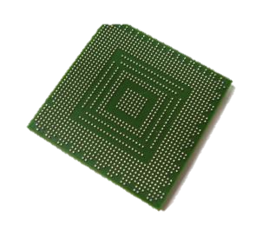
tile_static
The tile_static storage class
Second addition to the C++ language
Reflects hardware memory hierarchy
Within the tiled parallel_for_each lambda we can use
tile_static for local variables
indicates that the variable is allocated in fast cache memory
i.e. shared by each thread in a tile of threads
only applicable in restrict(amp) functions
http://blogs.msdn.com/b/nativeconcurrency/archive/2012/01/11/restrict-amp-restrictions-part-10-of-n-tile-static.aspx

Slide 31
tile_static storage class
imagine the code here

Slide 32
tile_static storage class
Notes:
Code has bug! Fixed with barrier next…

Slide 33
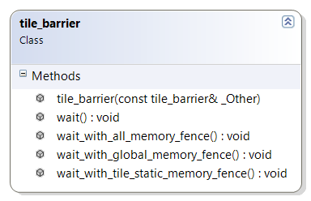
tile_barrier
class tile_barrier
synchronize all threads within a tile
e.g. t_idx.barrier.wait();
Plus
Fences (without barriers)
all_memory_fence, global_memory_fence, tile_static_memory_fence
Atomics
atomic_exchange, atomic_compare_exchange, atomic_fetch_*
http://blogs.msdn.com/b/nativeconcurrency/archive/2011/12/24/tile-barrier-in-c-amp.aspx
http://blogs.msdn.com/b/nativeconcurrency/archive/2012/01/04/c-amp-s-atomic-operations.aspx

Slide 34
tile_barrier class

Slide 35
Example: Matrix Multiplication (tiled) – part 1
void MatrixMultSimple(vector<float>& vC, const vector<float>& vA, const vector<float>& vB, int M, int N, int W )
{
array_view<const float,2> a(M, W, vA), b(W, N, vB);
array_view<float,2> c(M,N,vC); c.discard_data();
parallel_for_each(c.extent,
[=] (index<2> idx) restrict(amp)
{
int row = idx[0];
int col = idx[1];
float sum = 0.0f;
for(int k = 0; k < W; k++)
sum += a(row, k) * b(k, col);
c[idx] = sum;
} );
}
void MatrixMultTiled(vector<float>& vC, const vector<float>& vA, const vector<float>& vB, int M, int N, int W )
{
static const int TS = 16;
array_view<const float,2> a(M, W, vA), b(W, N, vB);
array_view<float,2> c(M,N,vC); c.discard_data();
parallel_for_each(c.extent.tile< TS, TS >(),
[=] (tiled_index< TS, TS> t_idx) restrict(amp)
{
int row = t_idx.global[0];
int col = t_idx.global[1];
float sum = 0.0f;
for(int k = 0; k < W; k++)
sum += a(row, k) * b(k, col);
c[t_idx.global] = sum;
} );
}

Slide 36
Example: Matrix Multiplication (tiled) – part 2
void MatrixMultSimple(vector<float>& vC, const vector<float>& vA, const vector<float>& vB, int M, int N, int W )
{
static const int TS = 16;
array_view<const float,2> a(M, W, vA), b(W, N, vB);
array_view<float,2> c(M,N,vC); c.discard_data();
parallel_for_each(c.extent.tile< TS, TS >(),
[=] (tiled_index< TS, TS> t_idx) restrict(amp) {
int row = t_idx.global[0]; int col = t_idx.global[1];
float sum = 0.0f;
for(int k = 0; k < W; k++)
sum += a(row, k) * b(k, col);
c[t_idx.global] = sum;
} );
}
void MatrixMultTiled(vector<float>& vC, const vector<float>& vA, const vector<float>& vB, int M, int N, int W )
{
static const int TS = 16;
array_view<const float,2> a(M, W, vA), b(W, N, vB);
array_view<float,2> c(M,N,vC); c.discard_data();
parallel_for_each(c.extent.tile< TS, TS >(),
[=] (tiled_index< TS, TS> t_idx) restrict(amp) {
int row = t_idx.local[0]; int col = t_idx.local[1];
tile_static float locA[TS][TS], locB[TS][TS];
float sum = 0.0f;
for (int i = 0; i < W; i += TS) {
locA[row][col] = a(t_idx.global[0], col + i);
locB[row][col] = b(row + i, t_idx.global[1]);
t_idx.barrier.wait();
for (int k = 0; k < TS; k++)
sum += locA[row][k] * locB[k][col];
t_idx.barrier.wait();
}
c[t_idx.global] = sum;
} );
}
imagine the code here
Phase 1
Phase 2

Slide 37
Example: Matrix Multiplication (tiled) – part 2
void MatrixMultSimple(vector<float>& vC, const vector<float>& vA, const vector<float>& vB, int M, int N, int W )
{
static const int TS = 16;
array_view<const float,2> a(M, W, vA), b(W, N, vB);
array_view<float,2> c(M,N,vC); c.discard_data();
parallel_for_each(c.extent.tile< TS, TS >(),
[=] (tiled_index< TS, TS> t_idx) restrict(amp) {
int row = t_idx.global[0]; int col = t_idx.global[1];
float sum = 0.0f;
for(int k = 0; k < W; k++)
sum += a(row, k) * b(k, col);
c[t_idx.global] = sum;
} );
}
void MatrixMultTiled(vector<float>& vC, const vector<float>& vA, const vector<float>& vB, int M, int N, int W )
{
static const int TS = 16;
array_view<const float,2> a(M, W, vA), b(W, N, vB);
array_view<float,2> c(M,N,vC); c.discard_data();
parallel_for_each(c.extent.tile< TS, TS >(),
[=] (tiled_index< TS, TS> t_idx) restrict(amp) {
int row = t_idx.local[0]; int col = t_idx.local[1];
tile_static float locA[TS][TS], locB[TS][TS];
float sum = 0.0f;
for (int i = 0; i < W; i += TS) {
locA[row][col] = a(t_idx.global[0], col + i);
locB[row][col] = b(row + i, t_idx.global[1]);
t_idx.barrier.wait();
for (int k = 0; k < TS; k++)
sum += locA[row][k] * locB[k][col];
t_idx.barrier.wait();
}
c[t_idx.global] = sum;
} );
}
Phase 1
Phase 2

Slide 38
C++ AMP at a Glance
restrict(amp, cpu)
parallel_for_each
class accelerator_view
class accelerator
class extent<N>
class index<N>
class array_view<T,N>
class array<T,N>
tile_static storage class
class tiled_extent< , , >
class tiled_index< , , >
class tile_barrier
Notes:
Tiled model done, now moving to (optional) more section

Slide 39
Error handling
/* Trying to use REF emulator on a machine that does not have it installed, throws runtime_exception */
try
{
accelerator a(accelerator::direct3d_ref);
}
catch(runtime_exception& ex)
{
std::cout << ex.what() << std::endl;
}
Some APIs can throw
e.g. parallel_for_each
Exceptions
concurrency::runtime_exception
concurrency::out_of_memory
concurrency::unsupported_feature
concurrency::invalid_compute_domain
concurrency::accelerator_view_removed
http://blogs.msdn.com/b/nativeconcurrency/archive/2012/01/27/c-amp-runtime-exceptions.aspx

Slide 40
<amp_math.h>
concurrency::fast_math
Wrap HLSL intrinsics
35 functions
Single-precision only
Sacrifice accuracy for speed
concurrency::precise_math
68 functions
Require full double precision
even for single precision functions
#include <amp.h>
#include <amp_math.h>
using namespace concurrency;
using namespace concurrency::fast_math;
// using namespace concurrency::precise_math;
int main() {
float a = 2.2f, b = 3.5f;
float result = pow(a,b);
std::vector<float> v(1);
array_view<float> av(1,v);
parallel_for_each(av.extent, [=](index<1> idx) restrict(amp)
{
av[idx] = pow(a,b);
});
}
http://blogs.msdn.com/b/nativeconcurrency/archive/2012/02/08/math-library-for-c-amp.aspx

Slide 41
<amp_graphics.h>, concurrency::graphics
norm/unorm scalar type
Short vector types (int_3, float_4, norm_2, etc.)
Swizzle expressions: myvec.yzx = int_3(1, 2, 3);
Textures – efficient access to 1d, 2d, 3d data
Element type is scalar or SVT of rank 1, 2 or 4
DX limitations apply
Different encodings supported
Interop with DX texture resources
http://blogs.msdn.com/b/nativeconcurrency/archive/2012/01/25/concurrency-graphics-in-c-amp.aspx
Notes:
No sampling in this release
DX limitations apply
Read/write but typically not both at the same kernel
16K limit on extent in each dimension
Different encodings supported
Specify #bits per scalar element

Slide 42
DirectX Integration, concurrency::direct3d
Weave C++ AMP code and data with DX-based applications
Leave data on the GPU for rendering
Example: n-body simulation
Populates an array of particular positions using parallel_for_each
Then read it in a vertex shader
20 intrinsics (bit manipulation, min, max, etc.)
C++ AMP type | DirectX type | C++ AMP interop API
array | ID3D11Buffer | *get_buffer, make_array
texture | ID3D11Texture1D/2D/3D | *get_texture, make_texture
accelerator_view | ID3D11Device | *get_device, create_accelerator_view
http://blogs.msdn.com/b/nativeconcurrency/archive/2011/12/29/interoperability-between-direct-3d-and-c-amp.aspx
http://blogs.msdn.com/b/nativeconcurrency/archive/2012/02/24/direct3d-namespace-and-hlsl-intrinsics-in-c-amp.aspx

Slide 43
Agenda checkpoint
Context
Code
IDE
Summary

Slide 44
Visual Studio 11
Organize
Edit
Design
Build
Browse
Debug
Profile

Slide 45
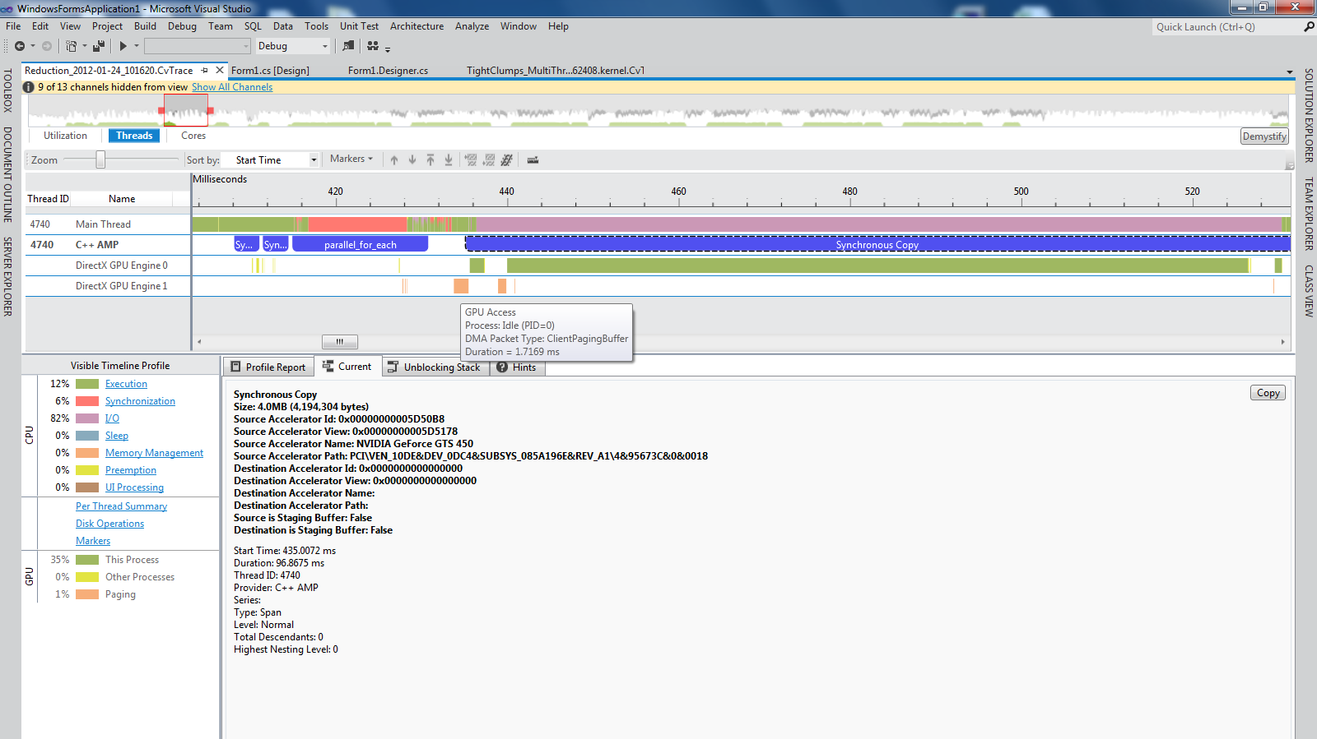
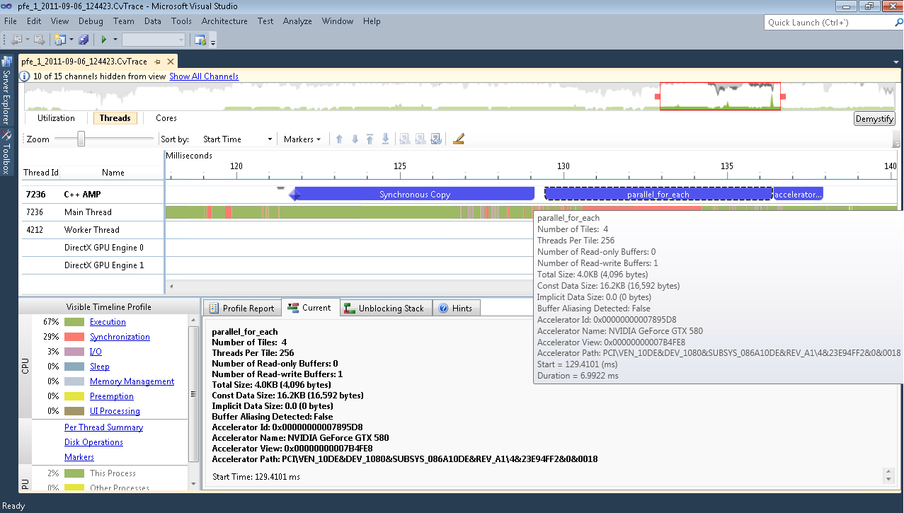
Visual Studio 11
Organize
Edit
Design
Build
Browse
Debug
Profile

Slide 46
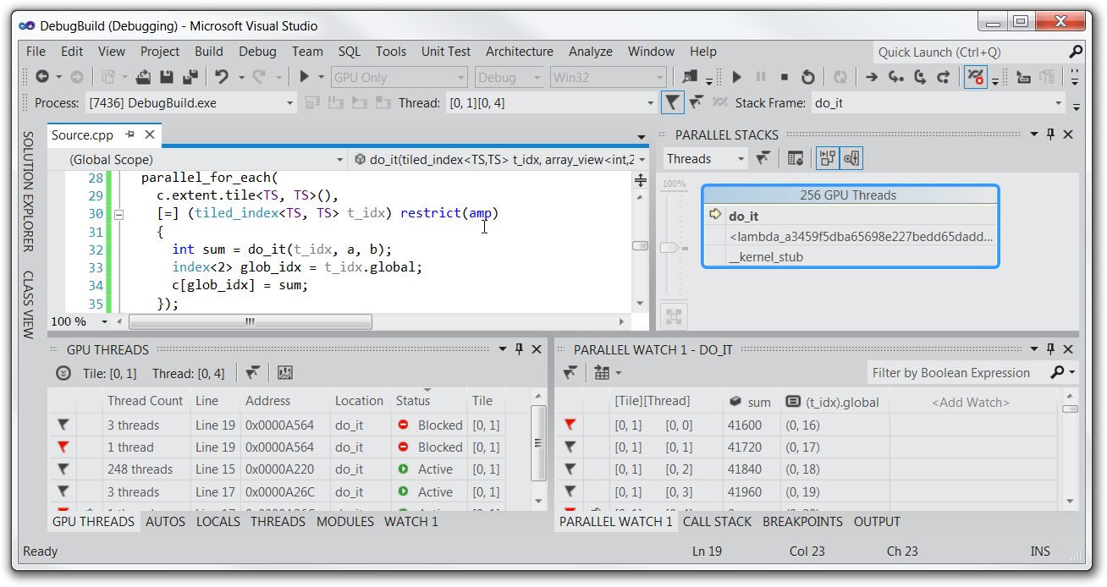
Visual Studio 11
Organize
Edit
Design
Build
Browse
Debug
Profile

Slide 47
C++ AMP Parallel Debugger
Well known Visual Studio debugging features
Launch (incl. remote), Attach, Break, Stepping, Breakpoints, DataTips
Toolwindows
Processes, Debug Output, Modules, Disassembly, Call Stack, Memory, Registers, Locals, Watch, Quick Watch
New features (for both CPU and GPU)
Parallel Stacks window, Parallel Watch window, Barrier
New GPU-specific
Emulator, GPU Threads window, race detection
concurrency::direct3d_printf, _errorf, _abort
http://channel9.msdn.com/Events/BUILD/BUILD2011/TOOL-802T (51:54-59:16)

Slide 48
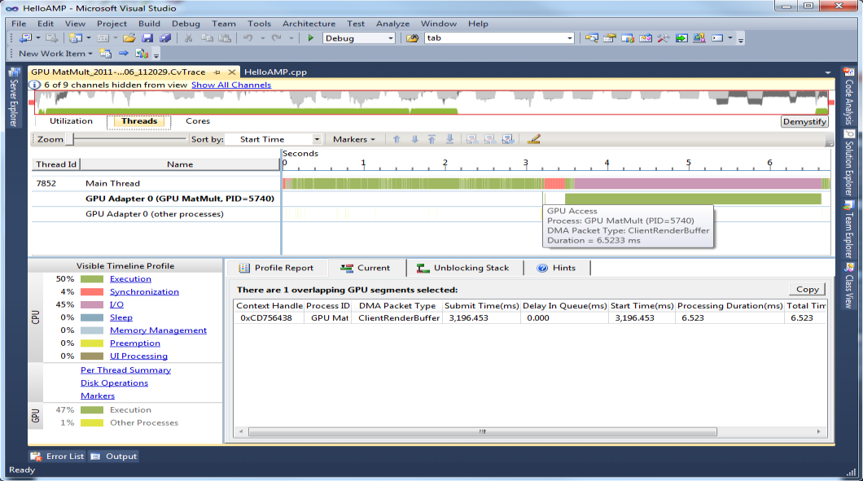
Concurrency Visualizer for GPU
Direct3D-centric
Supports any library/programming model built on it
C++ AMP specific events
Integrated GPU and CPU view
Goal is to analyze high-level performance metrics
Memory copy overheads
Synchronization overheads across CPU/GPU
GPU activity and contention with other processes
http://blogs.msdn.com/b/nativeconcurrency/archive/2012/03/09/analyzing-c-amp-code-with-the-concurrency-visualizer.aspx

Slide 49
Agenda checkpoint
Context
Code
IDE
Summary

Slide 50
Learn C++ AMP
book http://www.gregcons.com/cppamp/
training http://www.acceleware.com/cpp-amp-training
videos http://channel9.msdn.com/Tags/c++-accelerated-massive-parallelism
articles http://blogs.msdn.com/b/nativeconcurrency/archive/2012/04/05/c-amp-articles-in-msdn-magazine-april-issue.aspx
sampleshttp://blogs.msdn.com/b/nativeconcurrency/archive/2012/01/30/c-amp-sample-projects-for-download.aspx
guides http://blogs.msdn.com/b/nativeconcurrency/archive/2012/04/11/c-amp-for-the-cuda-programmer.aspx
spec http://blogs.msdn.com/b/nativeconcurrency/archive/2012/02/03/c-amp-open-spec-published.aspx
forum http://social.msdn.microsoft.com/Forums/en/parallelcppnative/threads
http://blogs.msdn.com/nativeconcurrency/

Slide 51
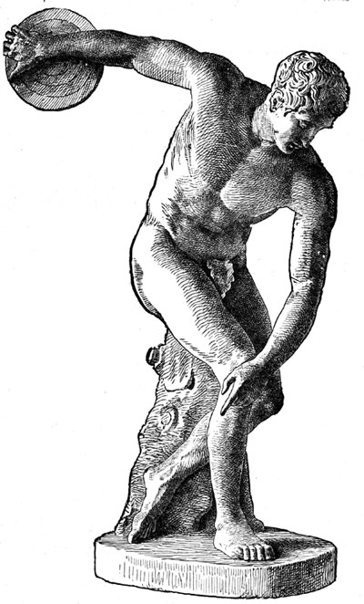
Summary
Democratization of parallel hardware programmability
Performance for the mainstream
Hardware abstraction platform
High-level abstractions in modern C++ (not C)
Future proof, minimal, data-parallel API
An open specification
State-of-the-art Visual Studio IDE
http://blogs.msdn.com/b/nativeconcurrency/archive/2012/02/03/c-amp-open-spec-published.aspx

Slide 52
© 2011 Microsoft Corporation. All rights reserved. Microsoft, Windows, Windows Vista and other product names are or may be registered trademarks and/or trademarks in the U.S. and/or other countries.
The information herein is for informational purposes only and represents the current view of Microsoft Corporation as of the date of this presentation. Because Microsoft must respond to changing market conditions, it should not be interpreted to be a commitment on the part of Microsoft, and Microsoft cannot guarantee the accuracy of any information provided after the date of this presentation. MICROSOFT MAKES NO WARRANTIES, EXPRESS, IMPLIED OR STATUTORY, AS TO THE INFORMATION IN THIS PRESENTATION.

