Slide 1
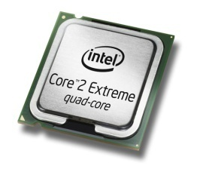
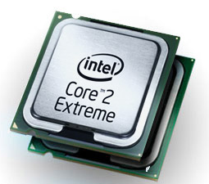


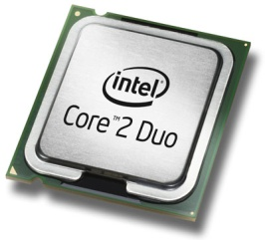
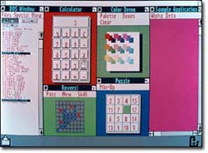
Parallel Computing Initiative
Limited
Advanced
Mainframes
Large, expensive
Minicomputers
Improved size
Limited application
PC
For individual use
Broader application
Complex computations
Steep learning curve
GUI
Personalized and visual
Easy to learn and use
Web
Socialized, community
Connected
Scalable access to info
Device/embedded
Anytime anywhere connected
Reach multiple economies
Parallel computing
Natural interaction
Multi-sensory experience
Adaptive, context-aware

Slide 2
Comprehensive View Of Concurrency
Area | Descriptions | Example Scenarios
Imperative Data Parallelism | Apply the same operation to common collections/sets in parallel. Looping, data partitioning, reductions, scans, etc. | Medical imaging Bond pricing
Task Parallelism | Simultaneously perform multiple independent operations. Divide-and-conquer, tasks, threads, fork/join, futures, etc. | Process control automation
Shared Resources | Building blocks for implementing concurrent components. Scalable and thread-safe collections, locks, etc. | Middle-tier configuration/state management
Declarative Data Parallelism | Define what computation needs to be done, without the how. Selections, filters, joins, aggregations, groupings, etc. | Statistical modeling
Coordination | Exploit latent operations by doing work while waiting for data. Asynch I/O, async interaction points, message passing, etc. | Streaming audio
Task Parallel Library
Parallel Pattern Library
OpenMP, Cluster SOA
Coordination Data Structures
Transactional Memory
PLINQ
MPI, MPI.net, CCR
Native Agents and Messaging
Maestro

Slide 3

Parallel Technologies from Microsoft
Applications
  Robotics-based manufacturing assembly line
  Silverlight Olympics viewer
Applications
  Automotive control system
  Internet – based photo services
IFx / CCR
Task Concurrency
Agents
WCF
Maestro
TPL / PPL
WF
Local Computing
Distributed Cloud Computing
Applications
  Ultrasound imaging equipment
  Media encode/decode
  Image processing/ enhancement
  Data visualization
Applications
  Enterprise search, OLTP, collab
  Animation / CGI rendering
  Weather forecasting
  Seismic monitoring
  Oil exploration
Data Parallelism
PLINQ
Cluster SOA
TPL / PPL
D-PLINQ
OpenMP
CDS
D-TPL
MPI / MPI.Net

Slide 4
Parallel Programming in Visual Studio 2010
Daniel Moth
http://www.danielmoth.com/Blog
Parallel Computing Platform
Microsoft Corporation

Slide 5
Parallelism in Visual Studio 2010
Integrated Tooling
Programming Models
Programming Models
PLINQ
Parallel
Debugger Toolwindows
Task Parallel
Library
Parallel Pattern Library
Agents
Library
Concurrency Runtime
Data Structures
Concurrency Runtime
Data Structures
Profiler Concurrency
Analysis
ThreadPool
Task Scheduler
Task Scheduler
Resource Manager
Resource Manager
Operating System
Threads
Key:
Tools
Native Library
Managed Library

Slide 6
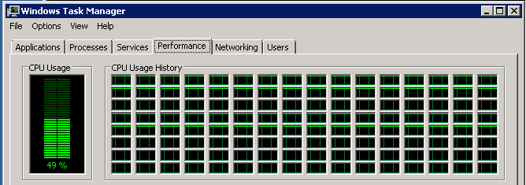
demo

Slide 7
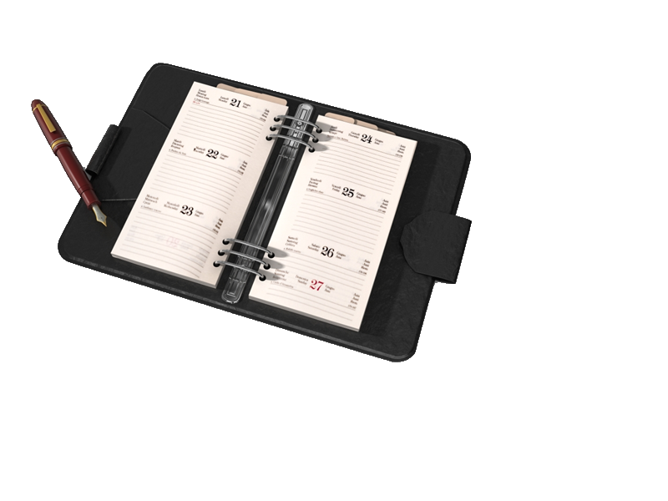
AGENDA
1. Set the scene
2. Task-based Programming
3. Debugger
4. Profiler
5. Structured Parallelism
6. PLINQ

Slide 8

From Thread-based to
Task-based programming model
demo

Slide 9
User Mode Scheduler
CLR Thread Pool
Global
Queue
Worker Thread 1
Worker Thread p
…
Program Thread

Slide 10
User Mode Scheduler For Tasks
CLR Thread Pool: Work-Stealing
Local
Queue
Local
Queue
Global
Queue
…
Worker Thread 1
Worker Thread p
…
Task 6
Task 4
Task 3
Task 1
Program Thread
Task 5
Task 2

Slide 11

Task: Rich API
demo

Slide 12
Task-based Programming Summary
ThreadPool
ThreadPool.QueueUserWorkItem(…);
System.Threading.Tasks
Starting
Parent/Child
Task.Factory.StartNew(…);
var p = new Task(() => {
var t = new Task(…);
});
Continue/Wait/Cancel
Task t = …
Task p = t.ContinueWith(…);
t.Wait(2000);
t.Cancel();
Tasks with results
Task<int> f =
new Task<int>(() => C());
…
int result = f.Result;

Slide 13
AGENDA CHECKPOINT
1. Set the scene
2. Task-based Programming
3. Debugger
4. Profiler
5. Structured Parallelism
6. PLINQ

Slide 14
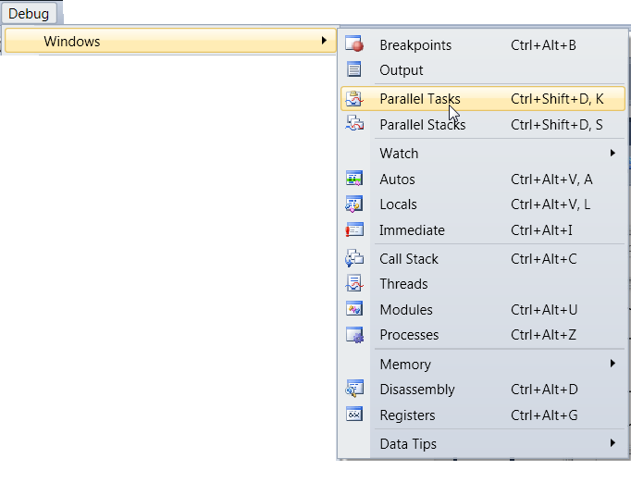
Debugging Parallel Apps in VS2010
Two new debugger toolwindows
  Support both native and managed
“Parallel Stacks”
  Call stacks of all threads or tasks
“Parallel Tasks”
  Scheduled, Running and Waiting

Slide 15
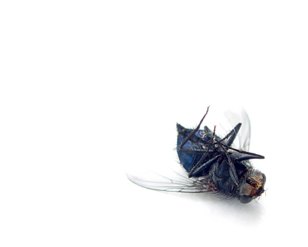
New Debugger toolwindows
demo

Slide 16
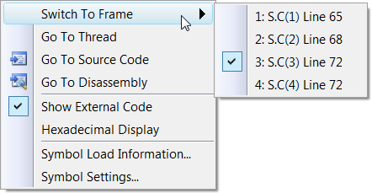
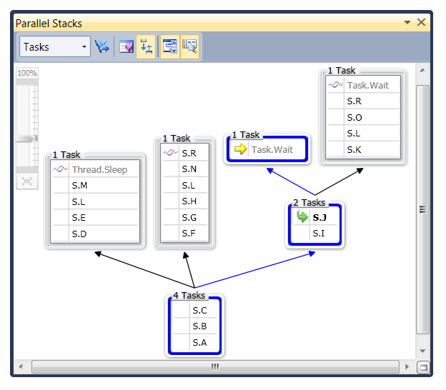


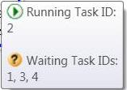
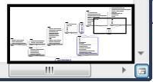
Parallel Stacks
active frame of
other thread(s)
Context menu
active frame of
current thread
current frame
Zoom
control
method tooltip
header tooltip
Blue highlights path of current thread
Bird’s eye view

Slide 17
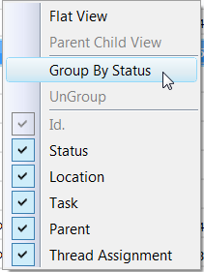
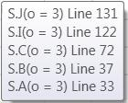
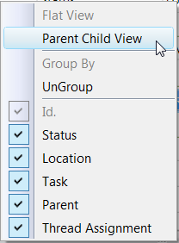
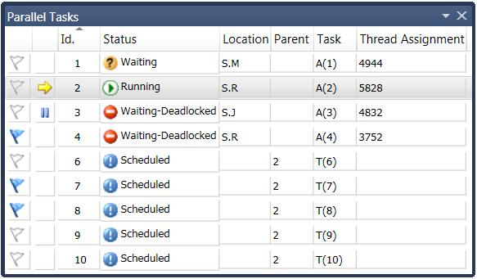
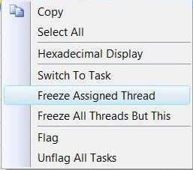

Parallel Tasks
Thread Assignment
Location + Tooltip
Status
Parent ID
Task Entry Point
Identifier
Current Task
Task’s thread
is frozen
Column contextmenu
Flagging
Tooltip shows info on waiting/deadlocked status
Item contextmenu

Slide 18
AGENDA CHECKPOINT
1. Set the scene
2. Task-based Programming
3. Debugger
4. Profiler
5. Structured Parallelism
6. PLINQ

Slide 19

Profiler through
Matrix Multiplication
demo

Slide 20
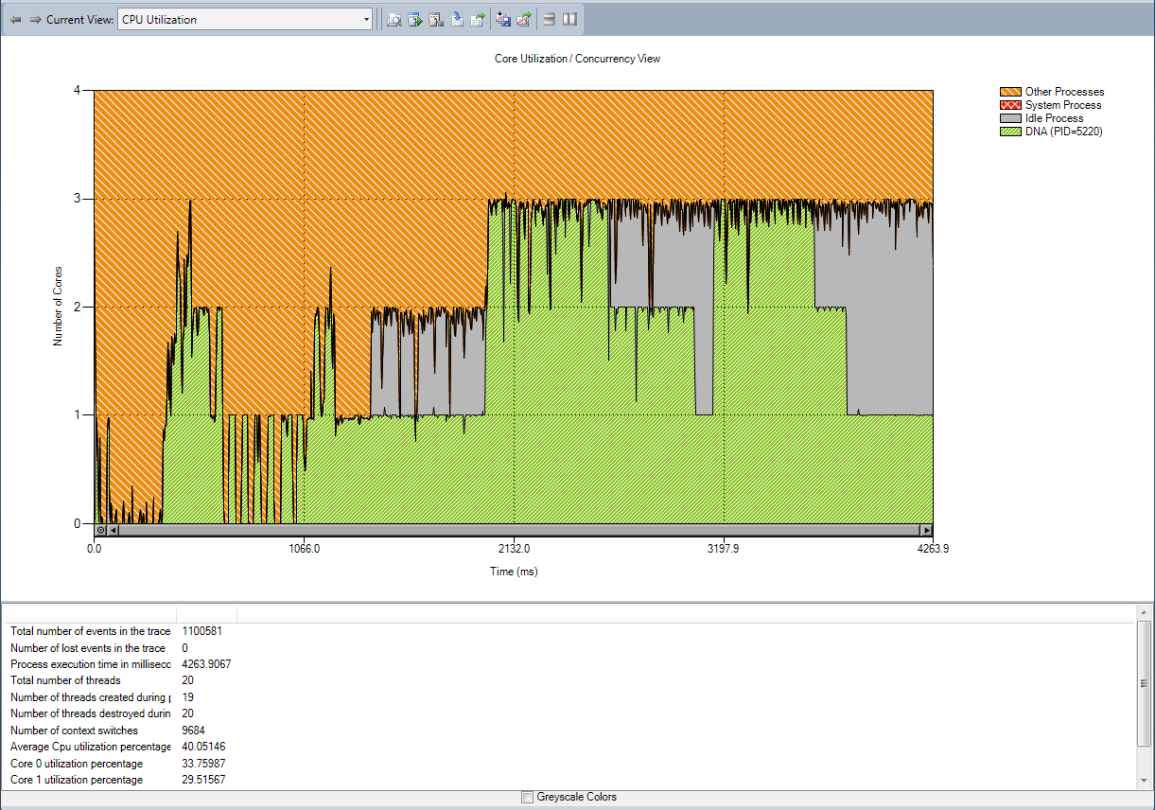
CPU Utilization
Other processes
Number of cores
Idle time
Your Process

Slide 21
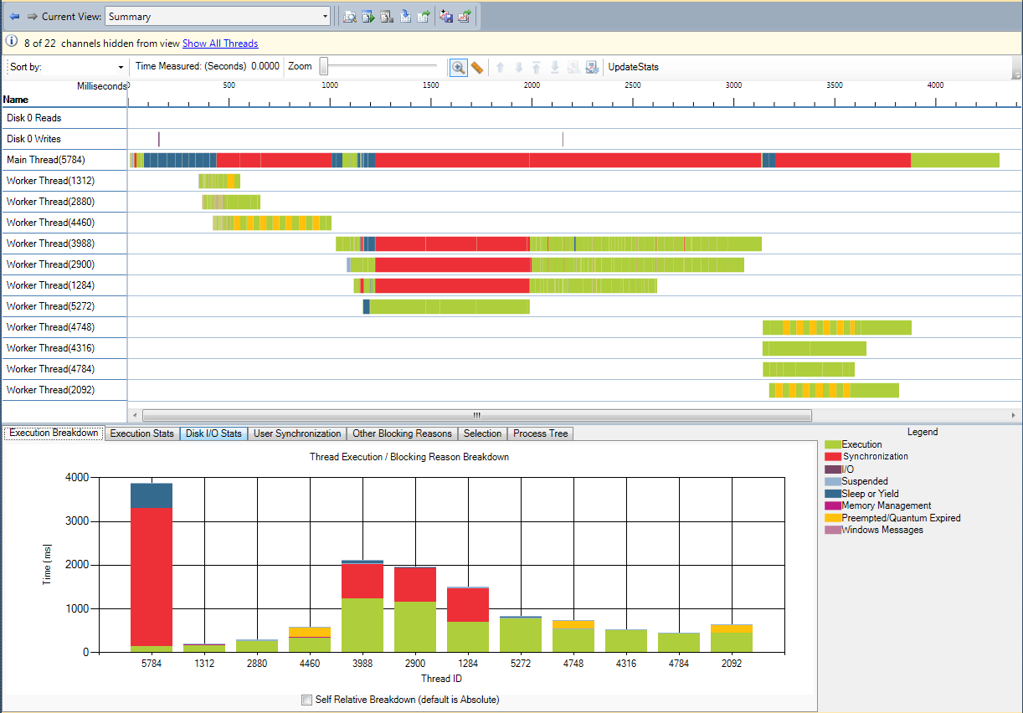
Thread Blocking
Measure time for interesting segments
Hide uninteresting threads
Zoom in and out
Detailed thread analysis
(one channel per thread)
Thread execution
breakdown
Legend

Slide 22
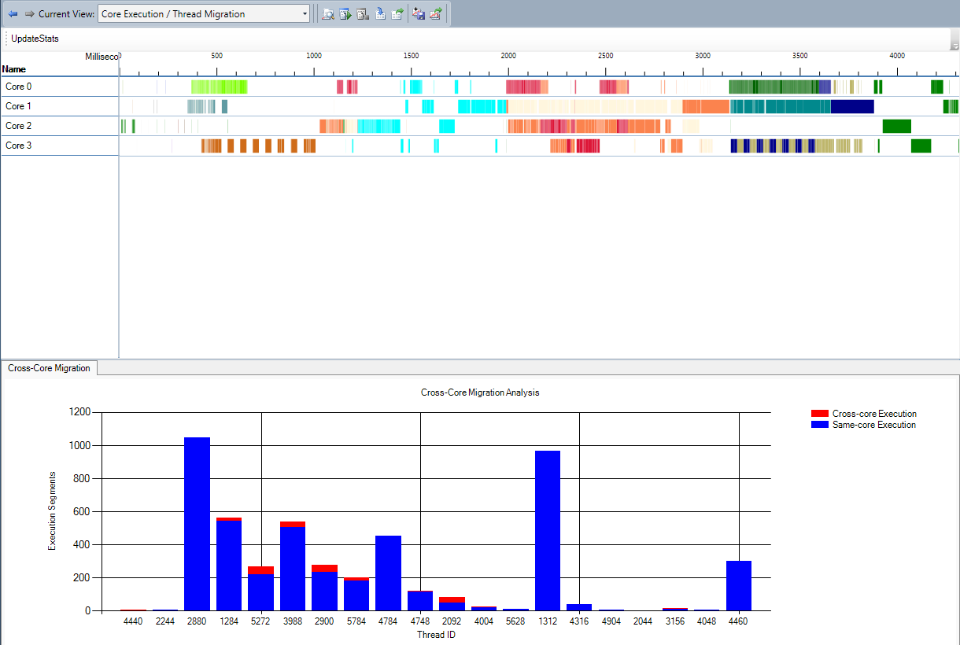
Core Execution / Thread Migration
Each core in a swim lane
One color per thread
This thread migrates across all four cores
Red indicates cross-core migrations

Slide 23
AGENDA CHECKPOINT
1. Set the scene
2. Task-based Programming
3. Debugger
4. Profiler
5. Structured Parallelism
6. PLINQ

Slide 24
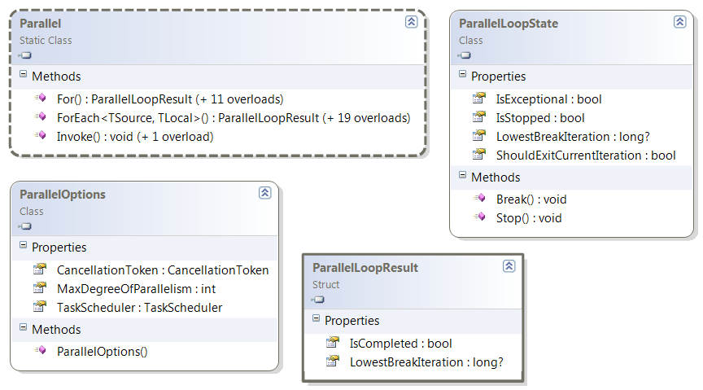
Structured Parallelism
Parallel class
  static (overloaded) methods
  helper methods to create/work with Tasks
  encapsulates common patterns

Slide 25

Parallel.Invoke/ForEach
demo

Slide 26
AGENDA CHECKPOINT
1. Set the scene
2. Task-based Programming
3. Debugger
4. Profiler
5. Structured Parallelism
6. PLINQ

Slide 27
Declarative Data Parallelism
Parallel LINQ-to-Objects (PLINQ)
  Built on top of Tasks
  Enables LINQ devs to leverage multiple cores
  Fully supports all .NET standard query operators
  Minimal impact to existing LINQ model
var q = from p in people
where p.Name == queryInfo.Name &&
p.State == queryInfo.State &&
p.Year >= yearStart &&
p.Year <= yearEnd
orderby p.Year ascending
select p;
.AsParallel()

Slide 28

Parallel LINQ
demo

Slide 29
PLINQ
Knobs
  AsParallel, AsSequential, AsOrdered, AsUnordered
  WithCancellation, WithDegreeOfParallelism,
  WithExecutionMode, WithMergeOptions
Works for any IEnumerable<T>
  Optimizations for other types
    T[], IList<T>
  Supports custom partitioning
    Partitioner<T>, OrderedPartitioner<T>

Slide 30
AGENDA CHECKPOINT
1. Set the scene
2. Task-based Programming
3. Debugger
4. Profiler
5. Structured Parallelism
6. PLINQ

Slide 31
Coordination Data Structures (1 of 3)
Block if full
Concurrent Collections
P
C
BlockingCollection<T>
ConcurrentBag<T>
ConcurrentDictionary<TKey,TValue>
ConcurrentLinkedList<T>
ConcurrentQueue<T>
ConcurrentStack<T>
IProducerConsumerCollection<T>
Partitioner, Partitioner<T>, OrderablePartitioner<T>
P
C
P
C
Block if empty

Slide 32
Coordination Data Structures (2 of 3)
Synchronization Primitives
Barrier
CountdownEvent
ManualResetEventSlim
SemaphoreSlim
SpinLock
SpinWait
Loop
Barrier
postPhaseAction
CountdownEvent.

Slide 33
Coordination Data Structures (3 of 3)
Initialization Primitives
MyMethod( )
Lazy<T>, LazyVariable<T>, LazyInitializer
ThreadLocal<T>
Cancellation Source
Foo(…, CancellationToken ct)
Cancellation Primitives
Thread Boundary
CancellationToken
CancellationTokenSource
ICancelableOperation
Bar(…, CancellationToken ct)
ManualResetEventSlim.Wait( ct )
Cancellation Token

Slide 34
Coordination Data Structures
Thread-safe collections
ConcurrentStack<T>
ConcurrentQueue<T>
ConcurrentLinkedList<T>
ConcurrentDictionary<TKey,TValue>
ConcurrentBag<TKey,TValue>
BlockingCollection<T>
IProducerConsumerCollection<T>
Partitioner, Partitioner<T>, OrderablePartitioner<T>
Initialization
ThreadLocal<T>
Lazy<T>, LazyVariable<T>, LazyInitializer
Synchronization
CountdownEvent
Barrier
ManualResetEventSlim
SemaphoreSlim
SpinLock
SpinWait
Cancellation
CancellationToken
CancellationTokenSource
ICancelableOperation

Slide 35


Summary
Visual Studio 2010 &
Framework 4.0
  Task Parallel Library
    Task, built on top of the revamped CLR ThreadPool
    Parallel.Invoke/For/ForEach
  Parallel LINQ
  Coordination Data Structures
  Debugger toolwindows
    Parallel Tasks, Parallel Stacks
  Parallel Performance Analyzer views
    CPU Utilization, Core Execution, Thread Blocking

Slide 36

Parallel Computing Resources
Downloads, Binaries, Code, Forums, Blogs, Videos, Screencasts, Podcasts, Articles, Samples
Download Visual Studio 2010 Beta1
  http://msdn.com/concurrency

Slide 37

© 2008 Microsoft Corporation. All rights reserved. Microsoft, Windows, Windows Vista and other product names are or may be registered trademarks and/or trademarks in the U.S. and/or other countries.
The information herein is for informational purposes only and represents the current view of Microsoft Corporation as of the date of this presentation. Because Microsoft must respond to changing market conditions, it should not be interpreted to be a commitment on the part of Microsoft, and Microsoft cannot guarantee the accuracy of any information provided after the date of this presentation. MICROSOFT MAKES NO WARRANTIES, EXPRESS, IMPLIED OR STATUTORY, AS TO THE INFORMATION IN THIS PRESENTATION.

