Slide 1
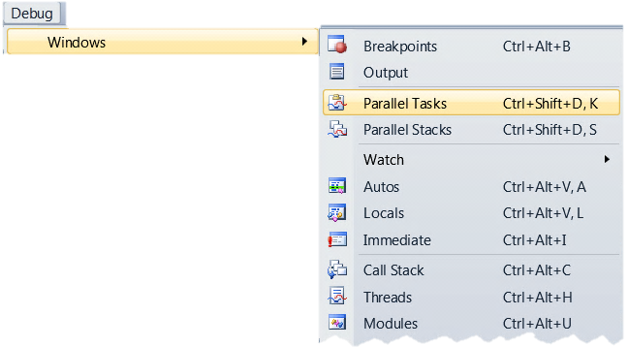
Parallel Debugging in VS2010
Two new debugger toolwindows
Support both native and managed
“Parallel Stacks”
Call stacks of all threads or tasks
“Parallel Tasks”
Scheduled, Running and Waiting
Notes:
See notes on all other slides

Slide 2
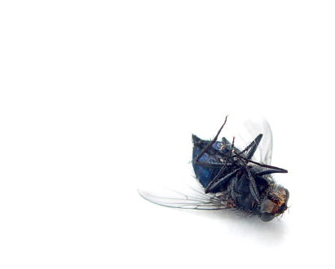
New Debugger toolwindows
demo
Notes:
http://channel9.msdn.com/posts/DanielMoth/Parallel-Tasks--new-Visual-Studio-2010-debugger-window/
http://channel9.msdn.com/posts/DanielMoth/Parallel-Stacks--new-Visual-Studio-2010-debugger-window/

Slide 3
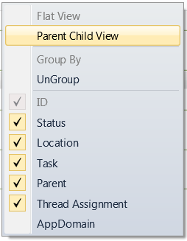
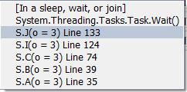
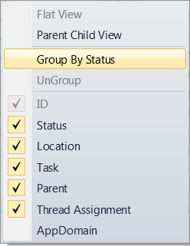
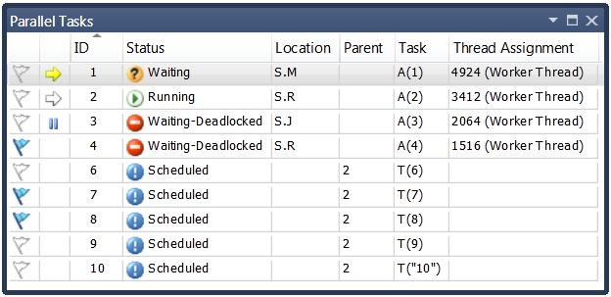
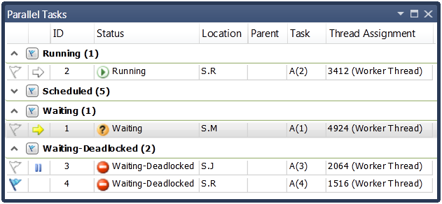
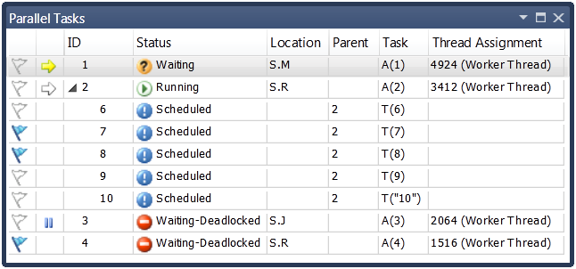
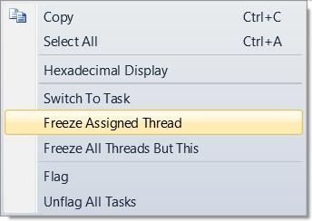
Parallel Tasks
Thread Assignment
Location + Stacktip
Parent ID
Status
Task Entry Point
Identifier
Current Task
BreakingTask
Task’s thread
is frozen
Column contextmenu
Flagging
Tooltip shows info on waiting/deadlocked status
Item contextmenu
Notes:
You can see all your tasks: running, waiting or scheduled, uniquely identified by their ID and further mapped to code via their Entry Point function, shown under the Task column.
For Running and Waiting tasks you can see the Location (inc. full real call stack of a task in a tooltip of that column) and the underlying thread information (under the Thread Assignment column).
For a Waiting task, you can see what it is waiting on (via the tooltip on the Status column) and if it is potentially deadlocked (via the icon).
You can easily identify (via the Parent column) and visualize (by using the menu to switch) parent child relationships between tasks. You can also group tasks (via the menu) based on a property of interest…
The new debugger toolwindow is truly integrated into the debugging experience, as expected from previous versions of Visual Studio. In particular, users of the old Threads window will feel at home with familiar features such as toggling hexadecimal display, same icons and concepts (e.g. current task/thread, frozen thread, flagging) and sharing of same settings for formatting display of call stacks.

Slide 4
Parallel Tasks
Support for TPL & PPL tasks
Helps answer questions
What threads are executing my tasks?
Where are my tasks running (location, call stack)?
Which tasks are blocked?
How many tasks are waiting to run?
Rich UI
Resizing, re-ordering, hiding, sorting, grouping, parent child view, flagging, copying
Notes:
http://www.danielmoth.com/Blog/2009/05/parallel-tasks-new-visual-studio-2010.html

Slide 5
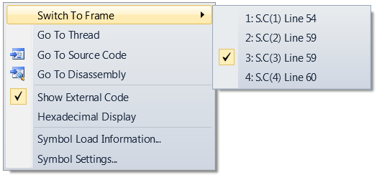
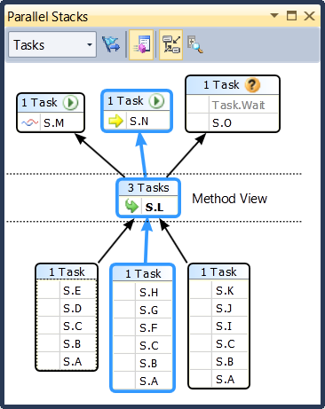
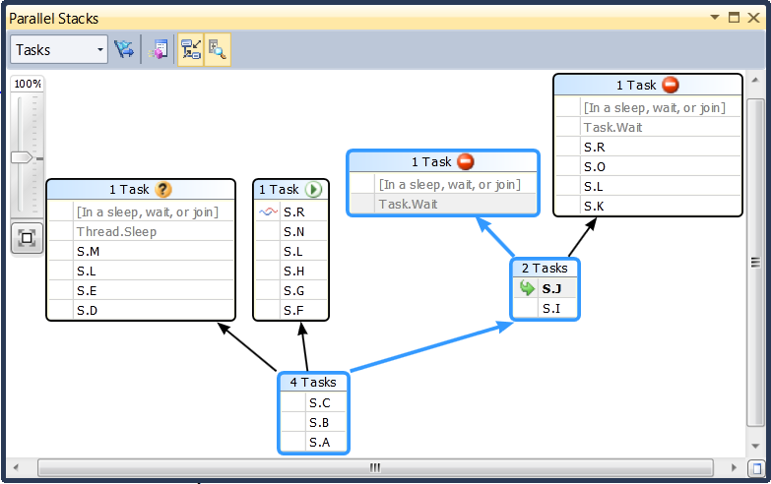
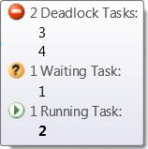
Parallel Stacks
active frame of
current thread
Context menu
active frame of
other thread(s)
current frame
Zoom
control
method tooltip
header tooltip
Bird’s eye view
Blue highlights path of current thread/task
Notes:
You can view all the call stacks of all the threads in a single view, including easy matching of a call stack to a thread ID (via tooltips).
You can easily distinguish the current thread (and stack frame) from all other threads (and stack frame) via the familiar icons.
You can navigate anywhere in the executing code by switching the stack frame (that drives the rest of the IDE). If you do the same from other places in the IDE, the Parallel Stacks window also reflects the change.
Common stack frames between threads (at the root of the call stacks) are coalesced together into call stack segments. This results in better use of screen real estate, as well as easy identification of "interesting" methods to focus on.
Common stack frames between threads (that have not been coalesced into the same call stack segment), are easily identifiable (bold). The developer can pivot on any method contexts via the Method View view (on the toolbar).
In addition to all of the above, the developer can switch the view to shows call stacks of tasks (instead of threads). In this Tasks view of the Parallel Stacks window, Threads that do not execute tasks at this moment in time are filtered out and the call stacks of threads executing tasks are trimmed on both ends so as to show only the real call stack as is relevant to the task. Also, call stacks of Threads executing more than one task are split to distinctly show the tasks on the view. Finally, thread information is replaced by task id information including the status.
In either view (Tasks or Threads) you can filter down the threads/tasks by showing flagged only threads/tasks. Flagging occurs in the Threads and Parallel Tasks windows respectively.
This new debugger toolwindow is truly integrated into the debugging experience, as expected from previous versions of Visual Studio. In particular, users of the Call Stack windows will feel that the Parallel Stacks is a natural extension.

Slide 6
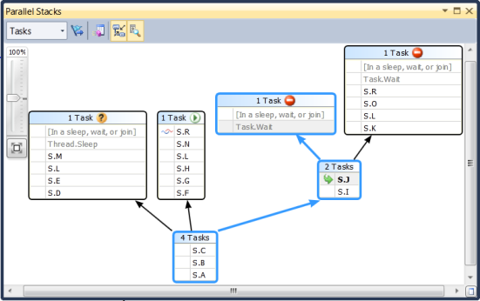
Parallel Stacks
Support tasks, but also thread-based apps
What it offers
Multiple call stacks in a single view
Coalescing of call stack prefixes
Task-specific view (inc. task status)
Easy navigation to any executing method
Rich UI
Graphical representation, zooming, panning, bird’s eye view, flagging, tooltips
Notes:
http://www.danielmoth.com/Blog/2009/05/parallel-stacks-another-new-vs2010.html
http://www.danielmoth.com/Blog/2009/05/parallel-stacks-tasks-view.html
http://www.danielmoth.com/Blog/2009/06/parallel-stacks-method-view.html

