Slide 1
MPI Cluster Debugging in VS2010
Facilitates the “F5” scenario
Eases the launch of an MPI application
Once the debugger is invoked, normal multi-process debugging takes place
Developer selects the cluster and related resources their app needs and then hits “F5”
Binaries get deployed and debugger is invoked
Developer debugs the multiple MPI processes
Works on local developer machine and on cluster
Notes:
http://www.danielmoth.com/Blog/2009/11/mpi-cluster-debugger-launch-integration.html

Slide 2
Feature Entry point
Project Properties dialog
Under “Configuration Properties”
Under “Debugging” change the “Debugger to launch”
“Local Windows Debugger” → “MPI Cluster Debugger”
Key property is the “Run Environment”
Launches the “Node Selector” dialog
Next two slides after the demo show screenshots
Notes:
See comments in next two slides

Slide 3
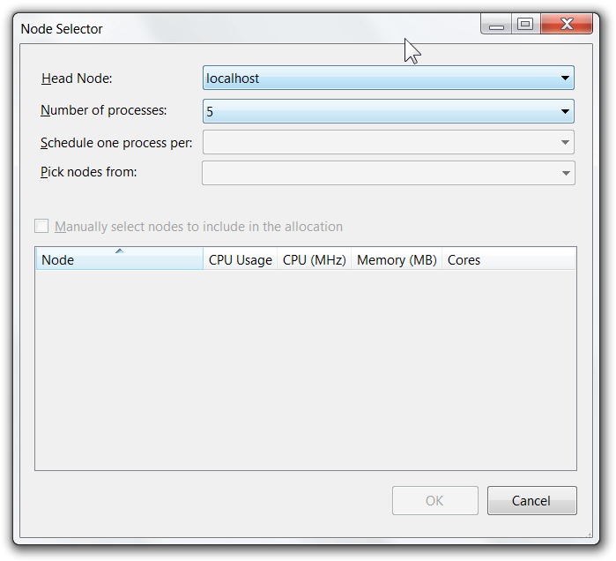
demo
Notes:
Demo recording
http://channel9.msdn.com/posts/DanielMoth/VS2010-MPI-Cluster-Debugger-launch-integration/
http://channel9.msdn.com/shows/The+HPC+Show/MPI-Cluster-Debugger-Visual-Studio-2010-Launch-Integration/

Slide 4
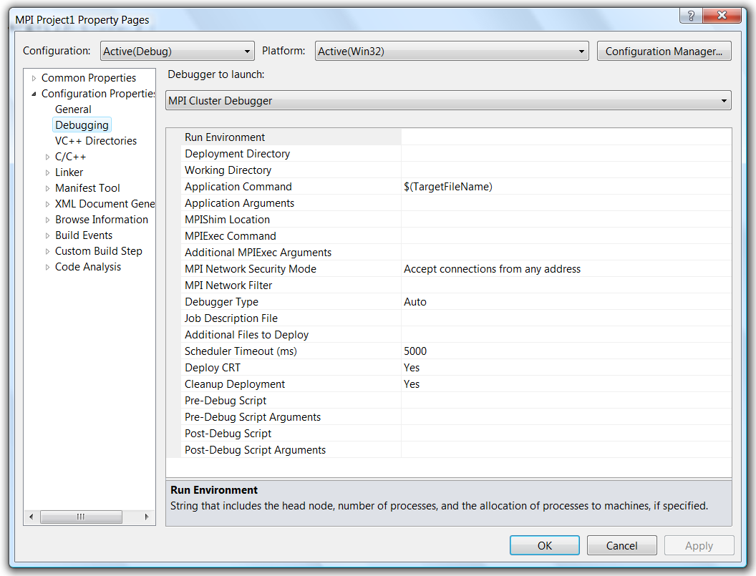
“Debugger to launch”
Notes:
Configuration Properties
http://msdn.microsoft.com/en-us/library/dd560807(VS.100).aspx

Slide 5
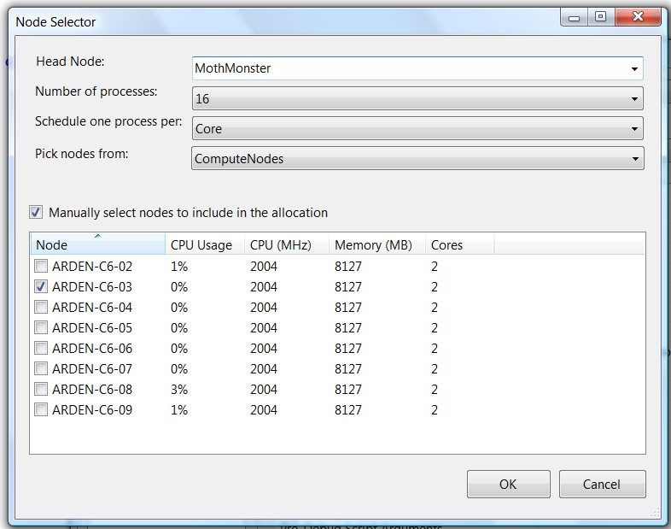
Node Selector
Notes:
How To
http://msdn.microsoft.com/en-us/library/dd560809(VS.100).aspx

